Slide 1
Human-Machine Interfaces for Operating a Blimp
Krebs Matthias, Ledergerber Anton
12.06.2012
Internal supervisors:
Javier Alonso Mora, Konrad Rudin

Slide 2
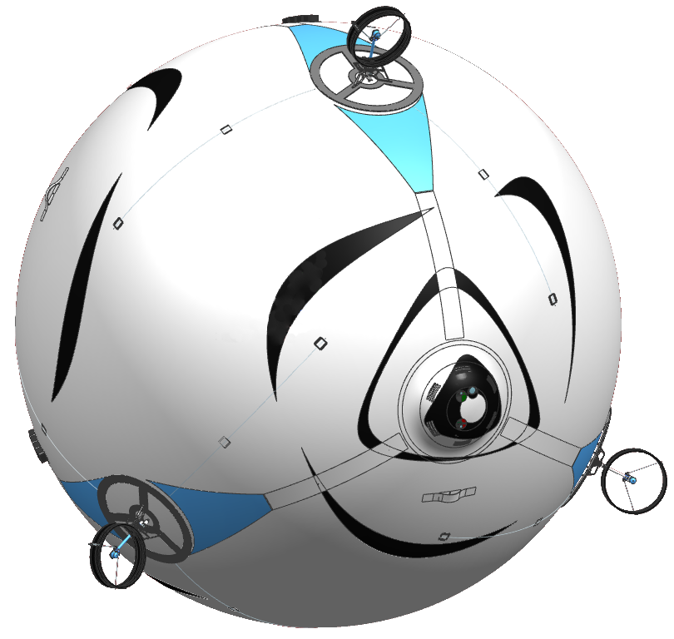
Motivation
Skye‘s unique property: 6 controllable degrees of freedom
Develop a unique HMI and generate Trajectories
Motor Platform
Camera System
Control Unit
Accelerometer Gyroscope Magnetoscope Barometer GPS
Spherical Hull
Filled with Helium
Communication
Xbee 2.4 GHz Fasst WiFi

Slide 3
Bachelor’s Thesis
Overview
Main tasks
Develop Control Modes for 6DoF Motion
Realize HMI
Generate 3D Trajectories
Content
HMI
Trajectories

Slide 4
Control Modes
Overview
Testphase
Control
Direct
Control
Assisted
Control
Half Automatic Control
Full Automatic Control
Development of Project skye

Slide 5
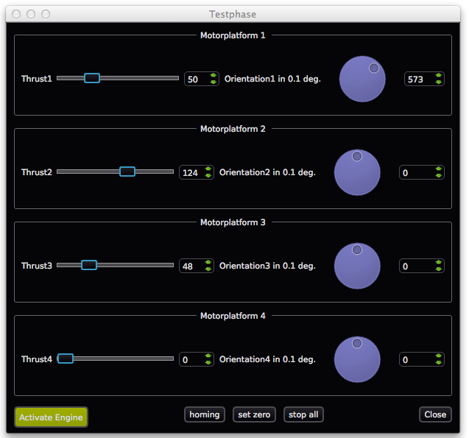
Control Modes
Testphase
✔
Tested on real
system
8Dof (Angles, Thrust)
Only for testing
Tested on real System

Slide 6
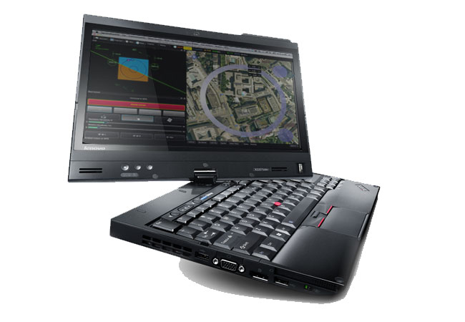
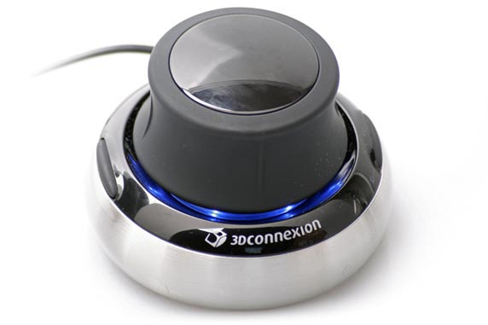
Control Modes
Direct Control
✔
Tested on real
system
6Dof (Forces, Moments)
Without Controler

Slide 7

Control Modes
Assisted Control
✔
Tested on real
System
(in Body
Frame)
6Dof (Velocities)
With Controler

Slide 8
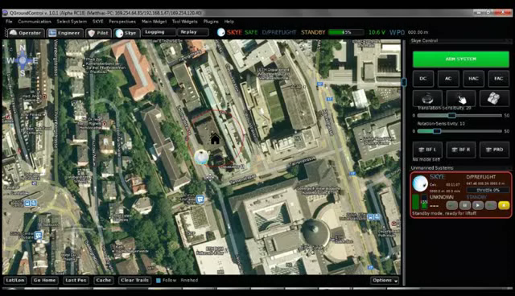
Control Modes
Half Automatic Control
✔
Tested in QGC
Simulation
3Dof (Rotational Velocities)
With Trajectory Controler

Slide 9
Control Modes
Full Automatic Control
✔
Tested in
Matlab
Simulation
To appear Video of Simulation
0 Dof
With Trajectory Controler
With set Target Point

Slide 10
Path/Trajectory
Trajectories
Body Frame
Inertial Frame

Slide 11
Approximation/Interpolation
Trajectories

Slide 12
Spline Degree
Trajectories
-cubic
-quartic
-quintic

Slide 13
Spline Degree, Mot_Alloc
Trajectories
C² seems to be sufficient!
C³ Continuity would be best!
Decision
Consider the other effects of the spline degree choice, if quartic has no drawbacks, choose quartic.

Slide 14
Parameterization
Trajectories
The decision of parameterization affect the geometry of the path as well as the properties of the trajectory!

Slide 15
Parameterization
Trajectories
Equally-distant
Chord-distant
Arc-distant
Centripetal

Slide 16
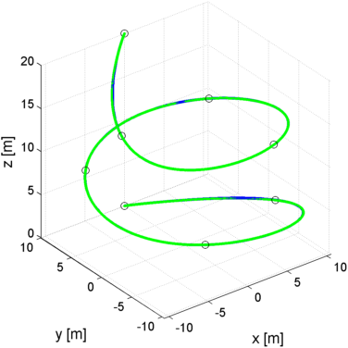
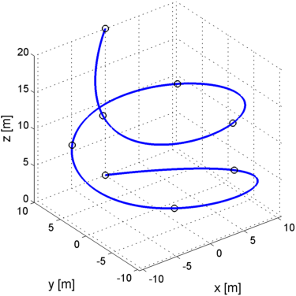
Trajectory-Controllers
Trajectories
Precise path tracking
Low power consumption
Time equivalence (trajectory tracking)
Trajectory
Trajectory and Simulation Trace

Slide 17
Trajectory-Control
Controllers
3 different approaches: Trajectory Following Pure Pursuit Cross Track
(Lookahead) (Closest Point)
Trajectory
Pos Control
Skye
Skye

Slide 18
Trajectory-Control
Controllers
3 different approaches: Trajectory Following Pure Pursuit Cross Track
(Lookahead) (Closest Point)
Trajectory
Vel Control
Skye
Skye

Slide 19
Trajectory-Control
Controllers
3 different approaches: Trajectory Following Pure Pursuit Cross Track
(Lookahead) (Closest Point)
Trajectory
Pos Control
Skye
Skye

Slide 20
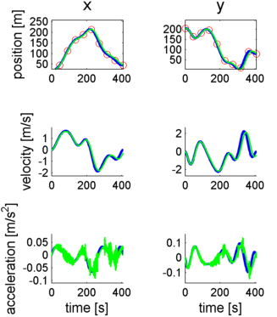
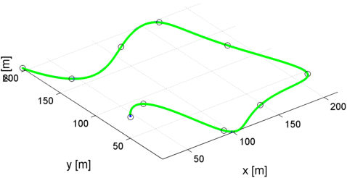
Evaluation
Absolute Results
J1: Average Deviation 0.01 m
J2: Average Acceleration 0.1 m/s²
J3: Used Time +/- 5%

Slide 21
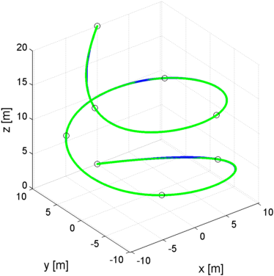
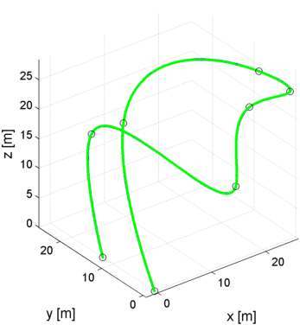
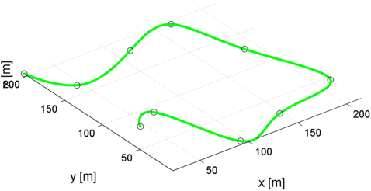
Evaluation
Different Waypoints
Path1
Path2
Path3
„ETH mainbuilding“ „Helix around tree“ „Agil maneuver“

Slide 22
Evaluation
Performance
Trajectoy Following
Pure Pursuit
Cross Track
Path1
Path2
Path3
Quintic
Quartic
Cubic
No wind, centripetal param.
J1: Average Deviation
J2: Average Acceleration
J3: Time (always exact)

Slide 23
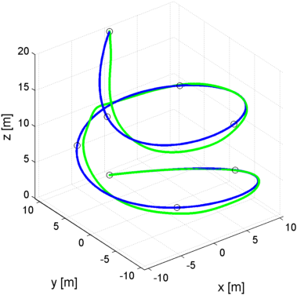
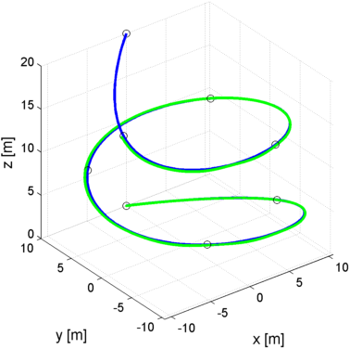
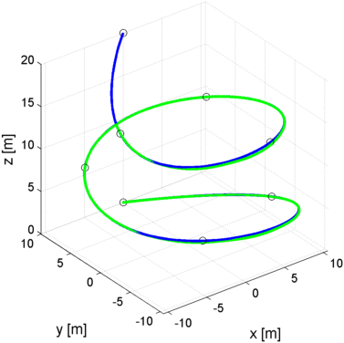
Evaluation
Performance
Trajectoy Following
Pure Pursuit
Cross Track
Path1
Path2
Path3
Quintic
Quartic
Cubic
Wind 1m/s, centripetal param.
J1: Average Deviation
J2: Average Acceleration
J3: Time (85-90%)

Slide 24
Evaluation
Performance
Trajectoy Following
Pure Pursuit
Cross Track
Path1
Path2
Path3
Quintic
Quartic
Cubic
Wind 1m/s, centripetal param.
J1: Average Deviation
J2: Average Acceleration
J3: Time (85-90%)

Slide 25
Evaluation
Performance
Trajectoy Following
Pure Pursuit
Cross Track
Path1
Path2
Path3
Quintic
Quartic
Cubic
Wind 1m/s, centripetal param.
J1: Average Deviation
J2: Average Acceleration
J3: Time 85-90%)

Slide 26
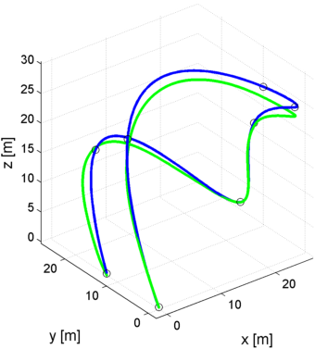
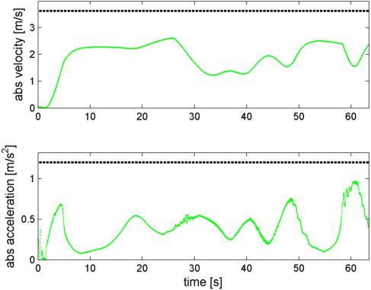
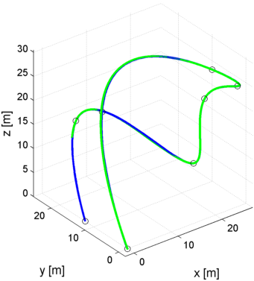
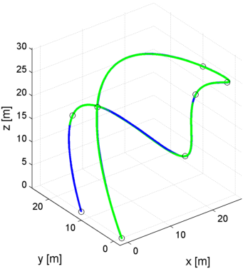
Evaluation
Robustness
Trajectoy Following
Pure Pursuit
Cross Track
Deviation: 0.010m -> 0.849 0.014m -> 0.041m 0.006m -> 0.069m
Acceleration: 0.114 -> 0.2389 0.1099 -> 0.1807 0.1088 -> 0.1879

Slide 27
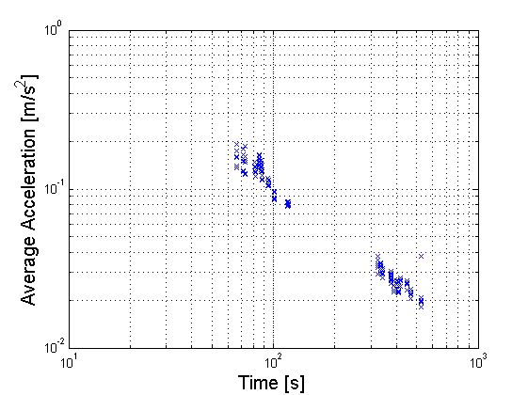
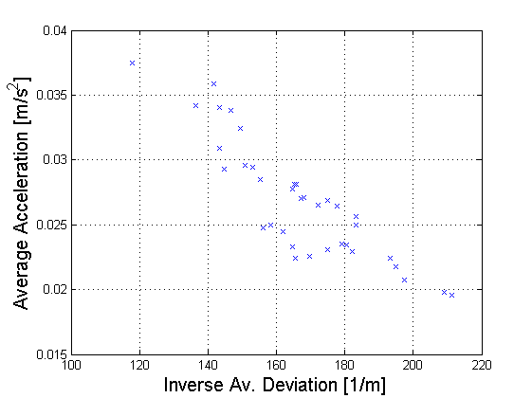
Evaluation
Correlation
The shorter the way, the higher the accelerations
Either acceleration or deviation will be height
Equally-distant
Chord-distant
Arc-distant
Centripetal
cubic
quartic
quintic

Slide 28
>> Backup

Slide 30
Evaluation
Correlation
Equally-distant
Chord-distant
Arc-distant
Centripetal
cubic
quartic
quintic

Slide 31
Evaluation
Correlation
Equally-distant
Chord-distant
Arc-distant
Centripetal
cubic
quartic
quintic
Road only

Slide 32
Evaluation
Correlation
Equally-distant
Chord-distant
Arc-distant
Centripetal
cubic
quartic
quintic

